Slide 1


Business Analysis
Report
ABC Retail Pvt. Ltd.
Project-Based Learning (PBL) | Subject: Business Analysis | Academic Year 2026–27
Student Name: Husandeep Singh and Arhan Ali Khan
UID: 26BCD10377,26BCD10384
Section: 26BCD-6B

Slide 2
Executive Summary
Business performance analysis of a fictional online retailer across Electronics, Home & Kitchen, Fashion, and Personal Care.
Revenue
Gross Profit
Operating Profit
Net Profit
₹72.0 lakh
₹20.9 lakh
₹11.1 lakh
₹9.1 lakh
Net Profit Margin
Current Ratio
Return on Equity
12.6%
3.33x
23.3%

Slide 3
Business Profile & Project Objectives
1 Evaluate financial performance
BUSINESS PROFILE
Online retail company
2 Analyse profitability and liquidity
Product categories: Electronics, Home & Kitchen, Fashion, Personal Care.
3 Understand customer and category performance
4 Analyse market position and growth opportunities
5 Identify key insights
6 Provide practical recommendations for sustainable growth
Business Data
Analysis
Insights
Recommendations
Better Decisions

Slide 4
Methodology
A structured six-step analytical approach from evidence to action.
01
Data Collection
02
Data Organisation
03
Financial Analysis
Financial, customer, product, and market data
Structured Excel worksheets
Income Statement, Balance Sheet, Cash Flow
04
Ratio Analysis
05
Market & Customer Analysis
06
Insights & Recommendations
Liquidity, profitability, efficiency metrics
Segments, categories, competitors, opportunities
Actionable business strategies

Slide 5
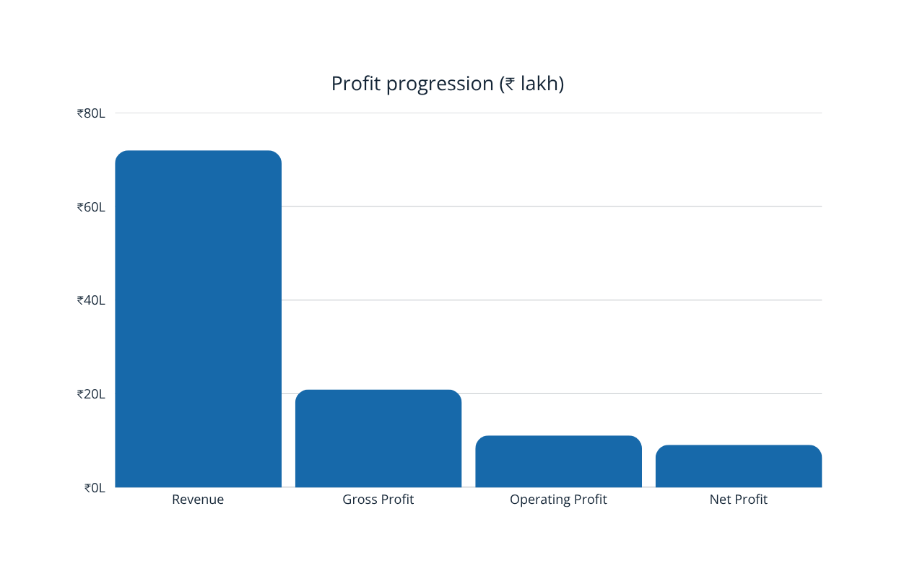
Financial Performance
Revenue
₹72.0 lakh
COGS
₹51.1 lakh
Gross Profit
₹20.9 lakh
Operating Profit
₹11.1 lakh
Net Profit
₹9.1 lakh
Net Profit Margin
12.6%
The company is profitable, generating ₹9.1 lakh net profit from ₹72.0 lakh revenue.

Slide 6
Balance Sheet & Cash Flow
Balance Sheet Highlights
Cash Flow Summary
Total Assets ₹60.0 lakh
Major Assets
Cash ₹8.5L • Accounts Receivable ₹7.0L
Inventory ₹12.5L • Other Current Assets ₹2.0L
Property & Equipment ₹30.0L
Equity & Liabilities
Share Capital ₹20.0L • Retained Earnings ₹19.0L
Long-Term Debt ₹12.0L • Current Liabilities ₹9.0L
Operating Activities
Investing Activities
+₹8.4 lakh
−₹4.0 lakh
Financing Activities
Net Increase in Cash
−₹1.5 lakh
+₹2.9 lakh
Opening Cash
Closing Cash
₹5.6 lakh
₹8.5 lakh
ASSETS = LIABILITIES + EQUITY
Positive operating cash flow indicates core business generates cash.

Slide 7
Financial Ratio Analysis
Liquidity and profitability indicators show a strong overall financial position.
Current Ratio
Quick Ratio
Gross Profit Margin
Operating Margin
Return on Equity (ROE)
3.33x
1.72x
29.0%
15.4%
23.3%
Strong short-term liquidity.
Covers short-term liabilities without inventory reliance.
₹29 gross profit per ₹100 revenue.
Positive operating profit after expenses.
Strong shareholder return.

Slide 8
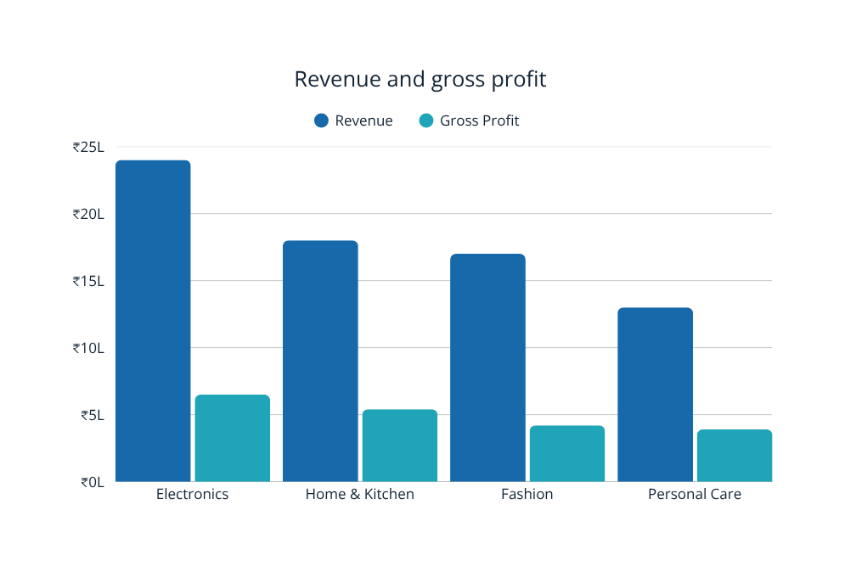
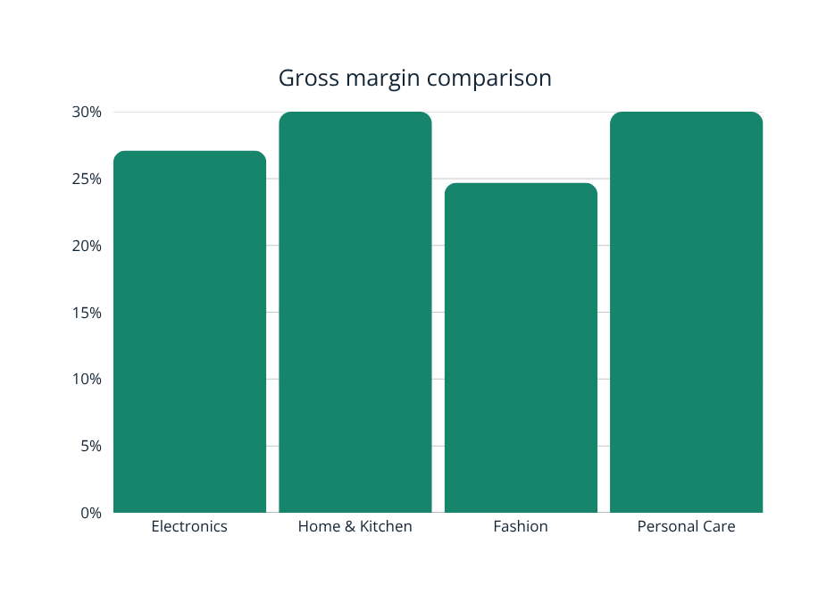
Category Performance Analysis
CATEGORY REVENUE COST GROSS PROFIT MARGIN
Electronics ₹24.0L ₹17.5L ₹6.5L 27.1%
Home & Kitchen ₹18.0L ₹12.6L ₹5.4L 30.0%
Fashion ₹17.0L ₹12.8L ₹4.2L 24.7%
Personal Care ₹13.0L ₹9.1L ₹3.9L 30.0%
Home & Kitchen and Personal Care have highest gross margins at 30.0%; Fashion has lowest margin at 24.7%.

Slide 9
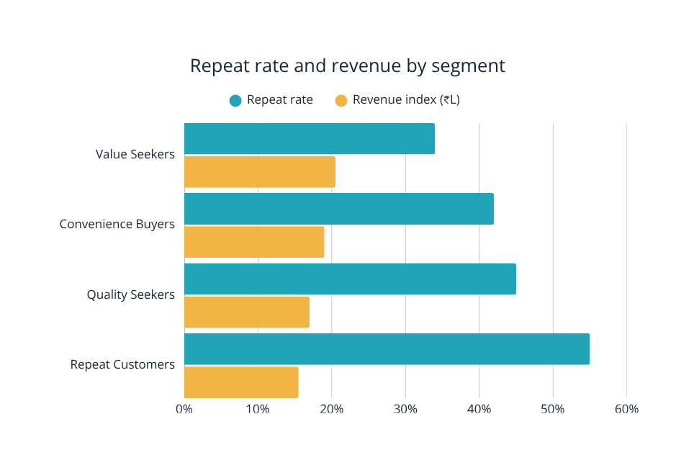
Customer Segmentation
HIGHEST REPEAT RATE
55%
Repeat Customers | Very High priority
SEGMENT CUSTOMERS ORDERS REVENUE REPEAT PRIORITY
Value Seekers 1,200 1,500 ₹20.5L 34% Medium
Convenience Buyers 900 1,300 ₹19.0L 42% High
Quality Seekers 700 900 ₹17.0L 45% High
Repeat Customers 850 1,100 ₹15.5L 55% Very High
Customer retention is a major growth opportunity.

Slide 10
Market Analysis
01 Growth of online / digital retail
02 Convenience is increasingly important
VALUE
CONVENIENCE
03 Customers focus on value and quality
04 Personalised offers enhance engagement
05 Retention supports recurring revenue
PRODUCT QUALITY
CUSTOMER EXPERIENCE
+ RETENTION
06 Profitability guides growth priorities

Slide 11
SWOT Analysis
STRENGTHS
WEAKNESSES
Positive profitability
Strong liquidity
Multiple product categories
Established customer base
Variation in category margins
Need for stronger customer retention
Optimisation needed in sales channels and costs
OPPORTUNITIES
THREATS
Online retail growth
Personalised marketing
Loyalty and retention programmes
Expansion of attractive-margin categories
Strong competition
Price pressure
Changing customer preferences
Rising customer acquisition costs

Slide 12
Key Findings
01
Profitable Business
02
Healthy Liquidity
Revenue ₹72.0L
Net Profit ₹9.1L
Current Ratio 3.33x
03
Margin Opportunity
04
Retention Opportunity
Home & Kitchen and Personal Care 30.0%; Fashion 24.7%
Repeat Customers
55% repeat rate

Slide 13
Recommendations
Four practical actions to convert analysis into sustainable growth.
1
Build a KPI Dashboard
2
Increase Direct Online Sales
Monitor revenue, profit margin, repeat purchase rate, returns, and customer acquisition cost.
Use website promotions, product bundles, personalised offers, and an improved customer experience.
3
Protect Profit Margins
4
Improve Customer Retention
Review pricing, procurement, marketing spend, and category profitability.
Launch loyalty programmes, repeat-purchase offers, personalised recommendations, and post-purchase engagement.

Slide 14
90-Day Action Plan
DAYS 1–30
DAYS 31–60
DAYS 61–90
MEASURE
OPTIMISE
GROW
• Build KPI dashboard
• Identify low-margin products
• Analyse customer behaviour
• Improve pricing and procurement
• Launch targeted customer campaigns
• Strengthen direct website sales
• Launch retention / loyalty initiatives
• Scale successful categories
• Review KPI performance
Increase profitable growth while improving customer retention and operational efficiency.

Slide 15
Thank You
ABC Retail Pvt. Ltd. demonstrates a positive financial position with profitable operations and healthy liquidity. The analysis shows opportunities to protect margins, focus on attractive categories, strengthen direct sales, and improve customer retention.
Data → Insight → Action → Sustainable Growth
Student Name: Husandeep Singh and Arhan Ali Khan
UID: 26BCD10377,26BCD10384
Section: 26BCD-6B

